Slide 1
Building Office Add-ins for Microsoft Word
Working with HTML, Images and Tables

Slide 2

Working with HTML, Images and Tables
HTML
Images
Tables
Demo
Notes:
In this unit, you'll learn how to work with HTML, images, and tables in Microsoft Word documents using the Office JavaScript API.

Slide 3
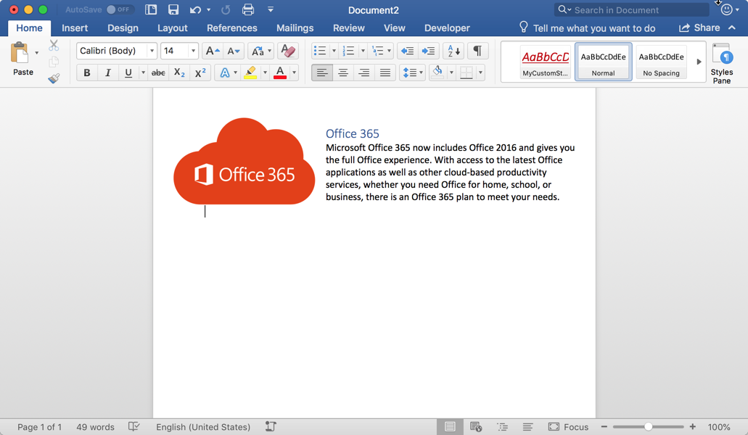
HTML in Word
Why HTML
Many developers will find it easier to interact with a Word document as HTML rather than Open Office XML (OOXML).
Office.js allows content to be written to or read from a document as HTML.
The document body, paragraphs, and ranges can all be manipulated as HTML using the getHtml and insertHtml operations.
Notes:
Many developers will find it easier to interact with a Word document as HTML rather than using the Open Office XML (OOXML). Open Office XML tends to be somewhat cryptic and difficult for developers to decipher.
Office.js enables developers to write or read content in a Word document as familiar HTML. The document body, paragraphs, and ranges can all be manipulated as HTML using the `getHtml()` and `insertHtml()` methods in the Word JavaScript API.

Slide 4
HTML in Word
// Inserts an HTML block at the end of a paragraph (also valid for body and range)
paragraph.insertHtml('<p style="font-family: verdana;">Inserted HTML.</p><p>Another paragraph</p>', "End");
// Get the HTML representation of the paragraph object (also valid for body and range)
var html = paragraph.getHtml();
Notes:
The following code writes a block of HTML at the end of a paragraph. This same code can also be used for the document body and a range of content:
To retrieve the contents of a paragraph as HTML, use the `getHtml()` method as the following code demonstrates:

Slide 5
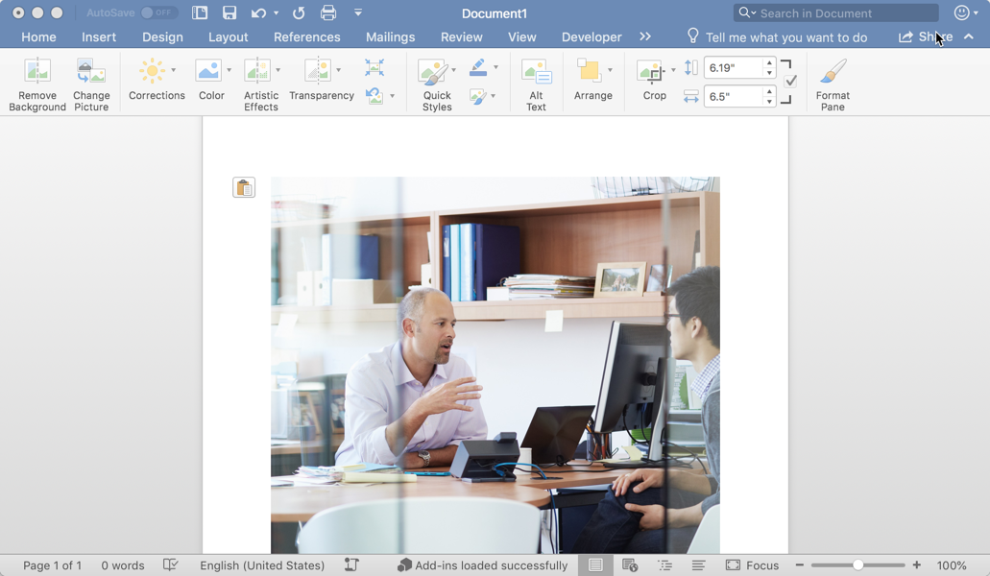
Images
Images
Images can be challenging to work with in JavaScript, but Office.js allows images to be manipulated as base64 encoded strings.
Images can be inserted into the body, paragraphs, or ranges of a document. All of these objects have an inlinePictures collection.
Office.js allows you to manipulate how the images is displayed in the document through properties such as lockAspectRatio, height, width, and more.
Notes:
Images can be challenging to work with in JavaScript, but Office.js allows images to be manipulated as base64 encoded strings. Images can be inserted into the body, paragraphs, or ranges of a document. Each of these objects have an `inlinePictures` collection that developers can write to.
Office.js allows you to manipulate how images are displayed in the document through properties such as `lockAspectRatio`, `height`, and `width` among others.

Slide 6
Images
// Get all inline pictures in body (also valid for paragraph or range)
const images = body.inlinePictures;
// Insert an image from base64 encoded string (insertLocation support “Start”, “End”)
context.document.body.insertInlinePictureFromBase64(base64Image, "End");
// Retrieves the base64 encoded string of an inline picture
var base64 = someInlinePicture.getBase64ImageSrc();
// Locks the aspect ratio and sets the width of an inline picture
someInlinePicture.lockAspectRatio = true;
someInlinePicture.width = 400;
Notes:
The first sample is getting all the inlinePictures in the body of the document
The second sample is inserting an image at the end of the body using a base64 string representation of the image
Next, you see how to read the base64 representation of an image using the getBase64ImageSrc function
Finally, we see how to lock the aspect ratio of an image and modify it’s width

Slide 7
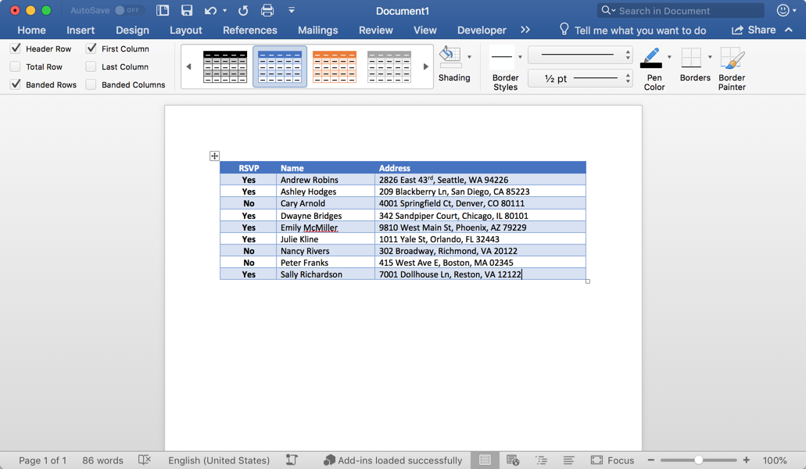
Tables
Tables
Office.js allows a table to be inserted relative to paragraphs, ranges and the body of a document.
The insertTable function specifies the dimensions of the table, the insert location, and a 2D array of values.
The tables property allows tables to be accessed and manipulated in JavaScript on body and range objects.
It is important to note that tables can be inserted relative to a paragraph, but a table does not exist within a paragraph (this is different from an inlinePicture).
Notes:
Office.js enables developers to insert a table relative to paragraphs, ranges, and the body of a document.
The `insertTable` method specifies the dimensions of the table and where to insert it. Data is added to the table by passing in a two dimensional array of values to the `insertTable()` method.
The `tables` property allows tables to be accessed and manipulated in JavaScript on the `body` and `range` objects.
> [!IMPORTANT]
> While a table can be inserted into the document relative to a paragraph, it doesn't exist within the paragraph. This differs from inline images covered in the previous section that are added to paragraphs.

Slide 8
Tables
// Get all tables in body (also valid for range)
const originalRange = body.tables;
// Inserts a 3x3 table into the paragraph
const tableData = [
["Name", "ID", "Birth City"],
["Bob", "434", "Chicago"],
["Sue", "719", "Havana"],
];
paragraph.insertTable(3, 3, "After", tableData);
// Get the number of rows in a table
var rows = table.rowCount;
// Gets the values from a table as a 2D array
var array2D = table.values;
Notes:
The following code demonstrates how to get a reference to all the tables in the body of a document.
> [!NOTE]
> While the previous code uses the `body` property on a document, the `tables` collection also exists on ranges as well.
To add a table with three columns and three rows of data, first create a two dimensional array that contains the content and include it as one of the arguments to the `insertTable()` method.
The table object contains properties to retrieve the number of rows in a table, using the `rowCount` property, as well as the contents of the table, using the `values` property.

Slide 9
Demo
Notes:
In this demo, we will look at an add-in for Microsoft Word that manipulates HTML, images, and tables
Open the completed solution located in the Demos/04 All Complete folder
Run npm install
Run npm run build
Run npm start
Side-load the add-in
Launch the add-in using the Show Taskpane button in the ribbon
Click Insert Image to insert an image
Click Insert HTML to insert rich HTML
Click Insert Table to insert a table into the document

Slide 10

Summary
HTML, images, and tables are powerful Office.js capabilities for creating attractive documents.
Office.js uses the base64 encoded string representation of inline pictures to make manipulation easy with JavaScript.
Tables are a first class citizen in Office.js and can be written to and read from with 2D string arrays

Slide 11
Reading further
Word Add-ins overview
https://docs.microsoft.com/en-us/office/dev/add-ins/word/word-add-ins-programming-overview
Word JavaScript API reference
https://docs.microsoft.com/en-us/office/dev/add-ins/word/
Word Add-in samples
https://github.com/OfficeDev?utf8=%E2%9C%93&q=word
InlinePicture and Table objects
https://docs.microsoft.com/en-us/javascript/api/word/word.inlinepicture
https://docs.microsoft.com/en-us/javascript/api/word/word.table

Slide 12
Thank you

